Slide 1
Hypothetical Document Embeddings (HyDE) for Unsupervised Dense Retrieval
CS421 Reproducilibility challenge
Firoz Shaik and Vishal Goud Mogili

Slide 2
Topic Introduction:
Paper Selected: Precise Zero-Shot Dense Retrieval without Relevance Labels
Reproducing Dense Retrieval Advancements:
In this research study, our work centers on reproducing and analyzing dense retrieval method called Hypothetical Document Embeddings (HyDE), crucial for tasks like web search and question answering.
Innovation in Reproduction - HyDE:
Traditional document retrieval often relies on labeled data, which can be resource-intensive to obtain. HyDE offers a unique solution by eliminating the need for such labeled data.
This innovative approach transforms dense retrieval into a two-step process, achieving zero-shot retrieval without labeled relevance and showcasing superior performance across diverse tasks and languages.

Slide 3
Background Overview:
Utilized Self-Supervised Representation Learning:
Investigated self-supervised representation learning methods, considering both token-level approaches using large language models (LLMs) and document-level approaches using text encoders pre-trained with contrastive objectives.
Inspiration from Language Models:
Drawn insight from LLMs trained to follow instructions and zero-shot generalize to diverse unseen instructions.
InstructGPT, a model trained to follow instructions, demonstrates that with a small amount of data, GPT-3 models can align with human intents.

Slide 4
Approach behind HyDE:
HyDE Framework:
The research paper proposes the HyDE framework, which decomposes dense retrieval into two tasks:
Generative Task: Instructs a language model (InstructGPT) to create a hypothetical document in response to a query, capturing "relevance" through the generative process.
Similarity Task: Utilizes an unsupervised contrastive encoder (Contriever) to encode the generated document, filtering out extra details and serving as a lossy compressor.

Slide 5
Approach behind HyDE:
Retrieval Process:
Searches the compressed vector against corpus embeddings using document-document similarity encoded during the contrastive pre-training stage.
Query-document similarity scores are no longer explicitly modeled or computed, and the retrieval task is cast into two tasks: Natural Language Understanding (NLU) and Natural Language Generation (NLG).
Adaptation and Supervision:
Requires no new model training; both the generative model and the contrastive encoder are used "out of the box" without adaptation or modification.

Slide 6
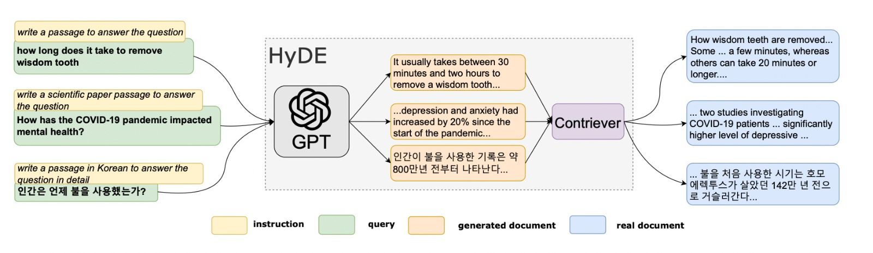
An illustration of the HyDE model

Slide 7
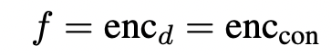


HyDE Methodology:
Contrastive Learning for Document Similarity:
Formula:
Explanation: Utilizes unsupervised contrastive learning to establish document-document similarity.
Query Vector Construction:
Formula:
Explanation: Constructs a query vector using an instruction-following language model based on the given query and instruction.
Encoding Generated Document:
Formula:
Explanation: Encodes a generated document using the document encoder to capture relevance patterns.

Slide 8


HyDE Methodology:
Encoding Actual Documents:
Formula:
Explanation: Encodes actual documents using the document encoder to maintain consistency.
Hypothesis Vector and Inner Product:
Formula:
Explanation: Computes the hypothesis vector by encoding a generated document and combines it with the query vector. The inner product determines document similarity, aiding in retrieval.

Slide 9

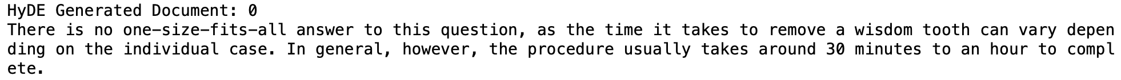
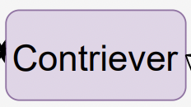
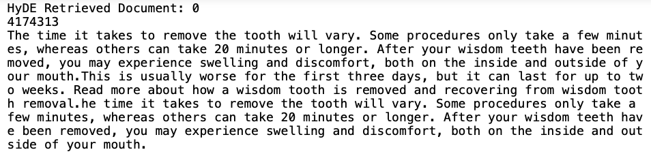
Results
Query to InstructGPT
Step 1: Generative Model Query
Objective: Create a Hypothetical Document
Action: Feed the query into the generative model.
Instruction: Instruct the model to "write a document that answers the question."
Expectation: The generative process captures "relevance" by providing an example.
Note: The generated document is not real and may contain factual errors, but it should be "like" a relevant document.
Step 3: Corpus Embedding Search
Objective: Retrieve Real Documents
Search Target: Use the encoded vector from Step 2.
Search Mechanism: Search against the corpus embeddings.
Outcome: Retrieve the most similar real documents.
Final Result: Return the retrieved real documents as the output.
GPT generated document
Step 2: Unsupervised Contrastive Encoding
Objective: Extract Relevant Information
Action: Use an unsupervised contrastive encoder.
Encoding Task: Encode the generated document into an embedding vector.
Encoder Function: Serve as a lossy compressor, filtering out extra (hallucinated) details from the embedding.
Result: Obtain a dense embedding vector that captures the essential information from the generated document.
Real document retrieved from Contriever

Slide 10
Key Findings:
HyDE introduces a groundbreaking approach to unsupervised dense retrieval, reshaping traditional methodologies.
The proposed Hypothetical Document Embeddings (HyDE) approach significantly improves zero-shot dense retrieval without relying on relevance labels.
HyDE, utilizing a combination of instruction-following language models and unsupervised contrastive encoders, outperforms state-of-the-art models across various search tasks, including web search, question answering, fact verification, and multilingual retrieval.

Slide 11
Ease and Difficulty in Reproducing:
What was easy:
The authors specified clear instructions and guidelines in their code repository for reproducing their work and made sure that they support all of types of machines like Windows, Linux, Mac (Intel Chip) and Mac (M-Series Chips).
What was difficult:
There were few errors while trying to install packages like pyserini, openai where there were issues with different versions of packages being not compatible with one another and related to failed building wheel for nmslib package. Installing the specific versions via pip install helped resolve this issue.
Also, more specific instructions on how to get and setup GPT3 API key would have been great.

Slide 12
Limitations and Future Work:
The HyDE method's real-time generation from LLMs may pose challenges for tasks requiring high throughput or low latency. However, advancements in hardware cost reduction and model compression techniques offer potential improvements in LLM inference efficiency.
HyDE, relying on contemporary LLMs like InstructGPT, may exhibit content preferences, introducing bias to search results.
OpenAI's efforts to address model bias and toxicity, along with user-guided generation through elaborate prompts, are expected to mitigate this issue. In contrast, traditional dense retrieval systems with opaque embeddings may face more challenges in uncovering and addressing biases.

Slide 13
Source and Acknowledgements
This study is taken from the proceedings of the ACL 2023 main conference and papers can all be found at the link here: https://aclanthology.org/volumes/2023.acl-long/
Source link: https://aclanthology.org/2023.acl-long.99/
Published by:
Luyu Gao, Xueguang Ma, Jimmy Lin, Jamie Callan
Language Technologies Institute, Carnegie Mellon University, David R. Cheriton School of Computer Science, University of Waterloo
{luyug, callan}@cs.cmu.edu, {x93ma, jimmylin}@uwaterloo.ca

Slide 14
Thank you

